Slide 1
Voice Control Home Automation
Course TITLE : PROJECT
SUPERVISED BY
Liton Chandra Paul
Assistant Professor
Department of Electronic and Telecommunication Engineering, PUST
SUBMITTED BY
SAJEEB CHANDRA DAS
Roll: 150542

Slide 2

Can we control all of our electric home appliances by our Voice Command ?

Slide 3
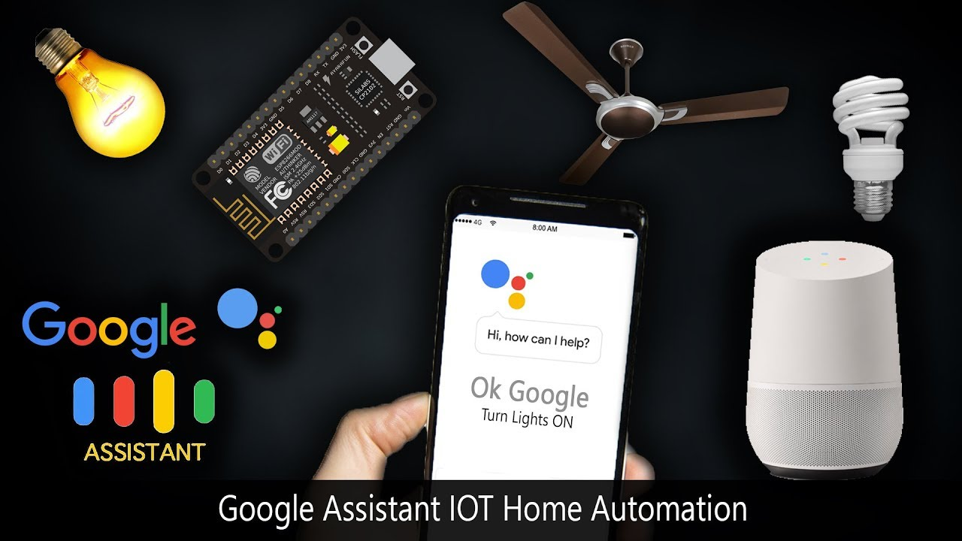
            Yes!
We can control all of our home appliances with our voice from all over the world via internet.
Lets know how it is possible.

Slide 4
CONTENTS
What is Voice Control Home Automation?
Why we have done this project?
Apparatus.
Design and construction.
System Architecture.
How it works?
Result.
Application.
Advantages.
Limitations.
Conclusion & Future Work .

Slide 5
What is Voice Control Home Automation?
Voice control home automation is a system where we can control our home appliances with our voice command by Google Assistant.
Google Assistant—IFTTT—Adafruit IO--NodeMCU (ESP8266)--4 channel Relay module.
Natural language voice is used to give commands to the Google Assistant. All of the components are connected over the internet using Wi-Fi which puts this system under the IoT.

Slide 6
Why we have done this project?
Easy, comfortable, effortless lifestyle at home.
Many other home automation technologies such as Google Home, Amazon Echo, Apple Home Kit, Philips Hue are highly costly then this project.
To control home appliances by voice commands with Google Assistant from anywhere.

Slide 7
Apparatus
ESP8266 NodeMCU.
4 channel 5V Relay Module.
Breadboard.
Jumper Wires.
9V Battery.
LM 7805 IC.
Electrical Switchboard.
Electric Wires.
Light (bulb).
Plugs.
Sockets.
AC Supply

Slide 8
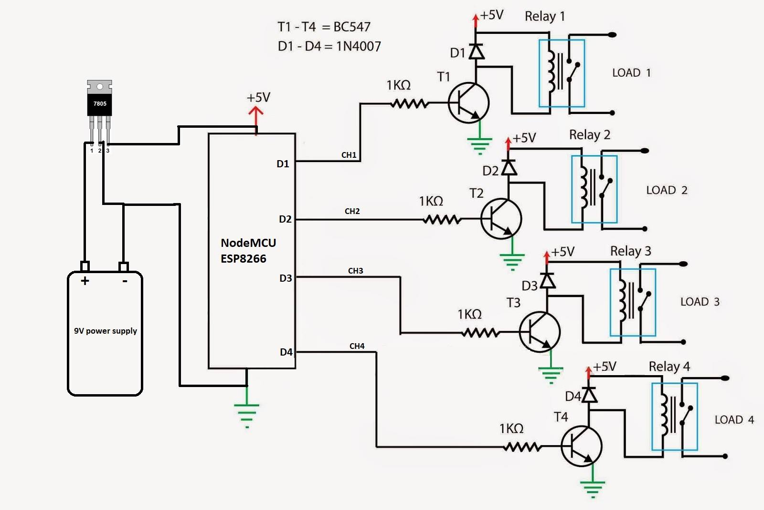
Design and construction

Slide 9
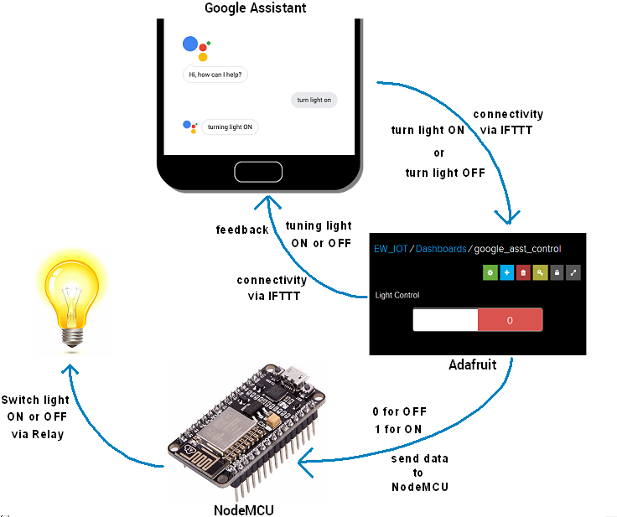
System Architecture.

Slide 10
How it works?
Connections : 4 output pin of ESP8266 NodeMCU with 4 channel of Relay module -- output of Relay module with physical AC Switchboard --give power supply to both.
Adafruit IO: Sign up – create Dashboard or Virtual Switchboard --save the username and Secret AIO key of Dashboard.
IFTTT: Sign up -- select Google Assistant platform -- create my own Applets with my commands -- connect with Adafruit IO Dashboard or virtual switchboard.
NodeMCU: Upload the code which contain local Wi-Fi username, password, Adfruit IO username and Secret AIO key of Dashboard.
Google Assistant: Give the Voice command to the Google Assistant and Enjoy the system…

Slide 11
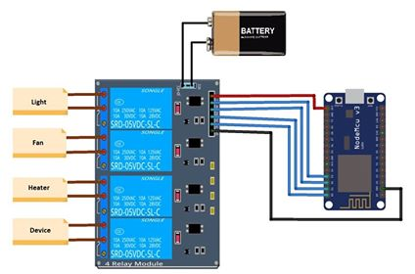

Slide 12
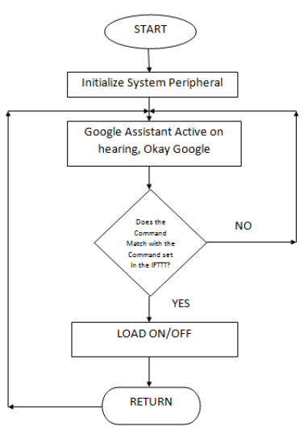
FLOWCHART

Slide 13
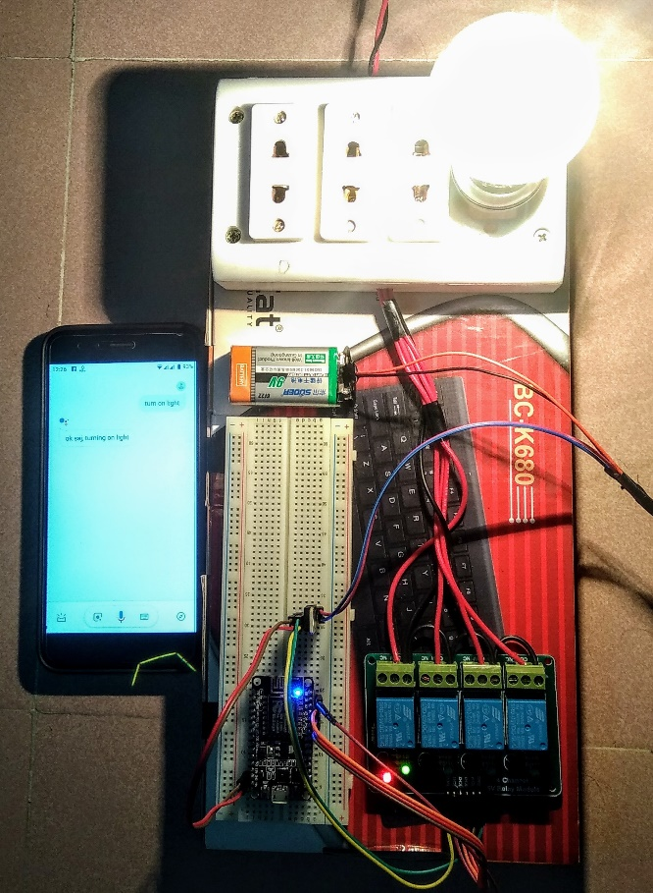
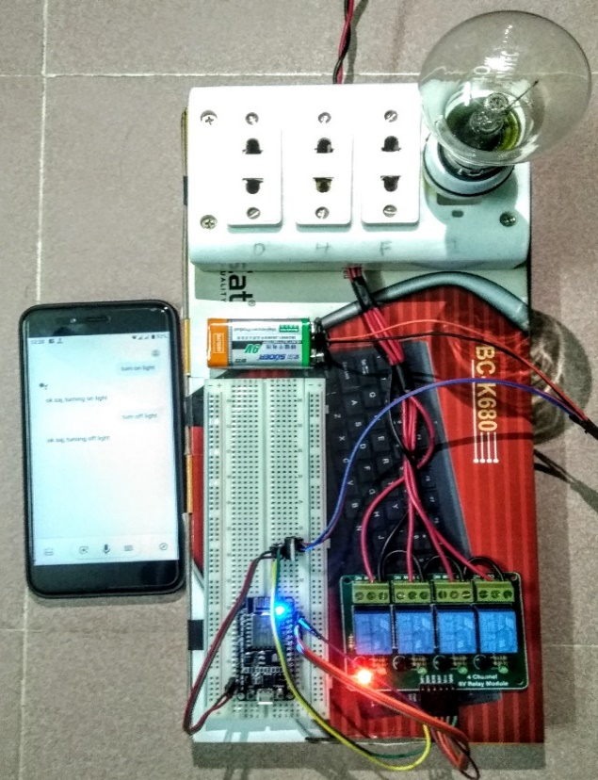
Result
The result was positive and the system responded well. The diagram below shows the complete prototype implementation of the proposed system.
Fig -7: Light Turned ON and then OFF.

Slide 14
Application
TV, Home Theater, Speaker.
Refrigerator, Washer, Dryer, Geyser water heater.
Light, Fan, Vacuum Cleaner, Air conditioner, Thermostat.
Electric Door Lock, CC camera etc.

Slide 15
Advantages
Automatic.
Control from all over the world.
High speed controlling.
Cost effective.

Slide 16
LIMITATIONS
Internet connection should be proper for speedy and continues services.
All the accounts should be signed up with the same Gmail account.
Power supply for both NodeMCU and Relay module should be same 5V source.
Voice command should be given in noise free space.

Slide 17
Conclusion & Future Work
To propose a cost effective voice controlled (Google Assistant) home automation.
Highly reliable and efficient for the aged people and differently abled person on a wheel chair who cannot reach the switch and are dependent on others.
Future scope depends on many factors to improve like speed, security, number of device, number of control parameter etc.
Well, no system is ever perfect. It always has a scope for improvement. One just needs to put on a thinking cap and try and make the system more better.

Slide 18

Lets make our Home Smart!

